Slide 1

COMM223 Marketing Management
Lecture 3 - Competitor Analysis and Marketing Research

Slide 2
Team Project
Source: anything that can help you have new product idea
Must be a consumer product
Must be a new product
Innovative product
Modified/improved product

Slide 3
Agenda
Company & Competitor analysis
Marketing research
Video discussion

Slide 4
Where are we now …
Company
Company Analysis
Competitor Analysis
Consumer Analysis
Marketing Management
Competitor
Consumer
Product
Promotion
Price
Distribution
Product - Market

Slide 5
SWOT Analysis
Internal factors (microenvironment) identify Strength and Weakness
External factors (macroenvironment) identify Opportunities and Threats
Together, they form the raw material of the SWOT analysis.

Slide 6
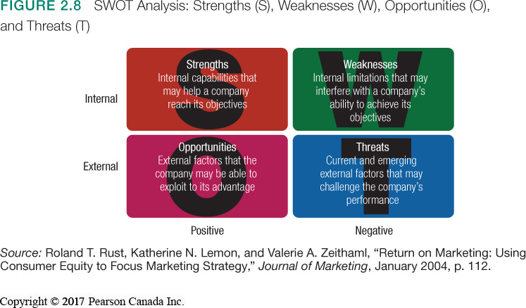

Slide 7
Macroenvironment Analyze Environment - Step 1
1) List “relevant” environment factors
Internal factors (Controllable)
Financial resources
Technological expertise (R&D, patent & MIS, etc.)
Cost Structure
Relationship with suppliers
Relationship with customers
Human resources
External factors (Uncontrollable?)
Competition
Political/Regulatory
Economic
Social/Cultural
Technological

Slide 8
Macroenvironment Analyze Environment - Step 2
2) Evaluate the impact of each relevant factor
Internal factors are usually evaluated against both existing and potential competitive rivals
Positive factors (Strengths)
What are our competitive advantages? What distinct competencies do we have?
Negative factors (Weaknesses)
In what areas are we vulnerable? Do we understand our resource limitations?

Slide 9
Macroenvironment Analyze Environment - Step2 (cont.)
2) Evaluate the impact of each relevant factor (cont.)
External factors are evaluated with respect to the positive and negative factors just identified
Positive factors (Opportunities)
What might we do? What do we do best? What must we do to take advantage?
Negative factors (Threats)
What are the potential risks? Will we lose our competitive advantage? Are there any obstacles? What are the possible constraints?

Slide 10
Relations among SWOT
Positive
Negative
Strengths
Weaknesses
Internal
Opportunities
Threats
External

Slide 11
Discussion: Starbucks SWOT analysis
Strength:
Weakness:
Opportunities:
Threats:

Slide 12
Competitor analysis
Analyze competition
Identify Competitive Advantage
Identify Competitors
Analyze Competitors
分析竞争
确定竞争优势
识别竞争对手
分析竞争对手

Slide 13
Competitive
Competitive –adjective
well suited for competition; having a feature that makes for successful competition;
having a strong desire to compete or to succeed.

Slide 14
Framework of Competitive Advantage
Positions of Advantage
Costs
Market Position
Technology/Product
Sources of Advantage
Superior Skills
Superior Resources
Effective Org processes
Performance Outcomes
Satisfaction
Customer Loyalty
Increased Market Share
Improved Profitability

Slide 15
Identify Competitive Advantages
Something that your company does especially well in comparison to your competitors.
Must be difficult for a competitor to imitate.
Types:
High Quality products
Low Cost/Low Price
Superior Customer Service
Convenient Distribution
与竞争对手相比，您的公司做得特别好。
竞争对手必须难以模仿。
类型：
高品质产品
低成本/低价
卓越的客户服务
便捷配送

Slide 16
Identify Competitors
Starbucks
Direct competitors:
Indirect competitors:

Slide 17
Analyze Competitors: The Strategy Profile
Customer’s Ratings of Competitors on Key Success Factors
 | Customer Awareness | Product Quality | Product Availability | Technical Assistance | Selling Staff
Competitor A | E | E | P | P | G
Competitor B | G | G | E | G | E
Competitor C | F | P | G | F | F
Note: E = excellent, G = good, F = fair, P = poor.

Slide 18
Marketing research

Slide 19
Marketing Information
Big data: the huge and complex data sets generated by today’s sophisticated information generation, collection, storage, and analysis technologies.
Marketers do not need more information; they need better information; and they need to make better use of the information they already have.

Slide 20
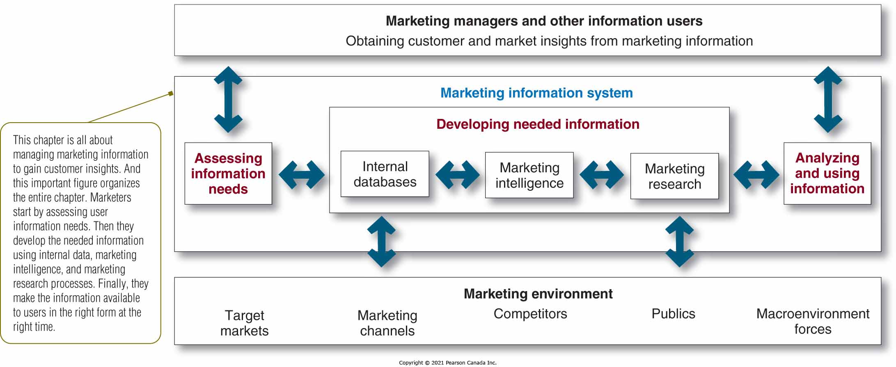
Marketing Information System

Slide 21
Marketing Info Systems Assessing Marketing Information Needs
The MIS serves company managers as well as external partners
The MIS must balance needs against feasibility:
Not all information can be obtained
Obtaining, processing, sorting, and delivering information is costly
MIS 为公司经理和外部合作伙伴提供服务
MIS 必须平衡需求与可行性：
无法获取所有信息
获取、处理、分类和传递信息的成本很高

Slide 22
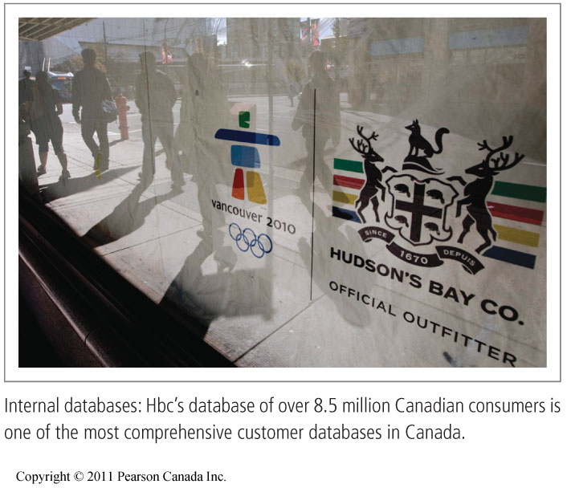
Marketing Info Systems Developing Marketing Information – Internal data
Information collected from different sources within the company, and stored within the organization’s information system
Accounting system
Operations/production
Sales reporting system
Past research studies
Internal data is cheap, quick, and easy
Collected for other purpose
May be incomplete or inappropriate to a particular situation
从公司内部不同来源收集的信息，并存储在组织的信息系统中
会计系统
运营/生产
销售报告系统
过去的研究
内部数据便宜、快速、简单
为其他目的而收集
可能不完整或不适合特定情况

Slide 23

Marketing Info Systems Developing Marketing Information – Competitive Marketing Intelligence
竞争营销情报是对有关竞争对手和营销环境趋势的公开可用信息的系统收集和分析。
主动跟踪组织营销环境中正在发生的事情
存在许多竞争信息来源：
员工、客户、贸易展览、网站、营销传播、供应商、经销商、专业信息服务和“垃圾箱潜水”
Competitive Marketing intelligence is the systematic collection and analysis of publicly available information about competitors and trends in the marketing environment.
Proactive approach to keeping track of what is going on within the organization’s marketing environment
Many sources of competitive information exist:
Employees, customers, trade shows, websites, marketing communications, suppliers, resellers, professional information services, and “dumpster diving”

Slide 24
Marketing Info Systems Developing Marketing Information – Marketing Research
Marketing research is the systematic design, collection, analysis, and reporting of data relevant to a specific marketing situation facing an organization.
A multi-step, purpose-driven process
Measure effectiveness of marketing actions, sales potential, try to understand consumer behaviour
Can be done by company personnel or contracted out to outside companies
营销研究是系统地设计、收集、分析和报告与组织面临的特定营销情况相关的数据。
一个多步骤、目标驱动的过程
衡量营销行动的有效性、销售潜力，尝试了解消费者行为
可由公司人员完成或外包给外部公司

Slide 25
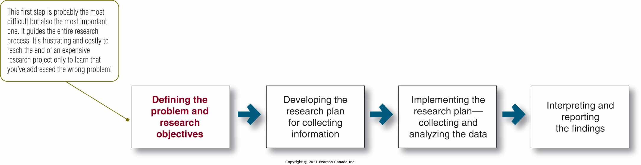
Steps in the Marketing Research Process

Slide 26
Step 1: Defining the problem and research objectives 定义问题和研究目标
Helps to know what you are looking for!
The manager and the researcher must work together.
These objectives guide the entire process.
Exploratory, descriptive, and causal research each fulfill different objectives.
经理和研究人员必须一起工作。
这些目标指导整个过程。
探索性研究、描述性研究和因果研究各自实现不同的目标。

Slide 27
Step 1: Defining the problem and research objectives
Exploratory research:
Research conducted to gather information to
Help better define problems and opportunities
Observation and interview are commonly used for this purpose
Descriptive research:
Research conducted to better describe marketing problems, situations, or markets, such as
Demographic characteristics of markets, attitudes of consumers, and market potential for a product
Surveys and personal interviews are commonly used
Causal research:
Research to test hypotheses about cause and effect relationships between variables of interest
Experimental approach
探索性研究：
为收集信息而进行的研究
帮助更好地定义问题和机会
观察和访谈通常用于此目的
描述性研究：
为更好地描述营销问题、情况或市场而进行的研究，例如
市场的人口特征、消费者的态度和产品的市场潜力
调查和个人访谈是常用的
因果研究：
研究以检验有关感兴趣变量之间因果关系的假设
实验方法

Slide 28
Step 2: Developing the Research Plan 制定研究计划
Translating the research objectives into specific information needs
Research plan is a written document which outlines the type of problem, objectives, data needed, and the usefulness of the results. Includes:
Secondary data: Information collected for another purpose which already exists
Primary data: Information collected for the specific purpose at hand
将研究目标转化为特定的信息需求
研究计划是一份书面文件，它概述了问题的类型、目标、所需的数据以及结果的有用性。包括：
次要数据：为其他目的而收集的已存在的信息
主要数据：为特定目的而收集的信息

Slide 29
Secondary vs. Primary Data
Internal data (inside the firm)
Financial statements, research reports files, customer letters, sales call reports, and customer lists
Secondary data
Facts and Figures
Already recorded prior to the project
External data (outside the firm)
U.S. Census reports, trade association studies, and magazines, business periodicals, and commercial reports
Data
Facts & figures pertinent to the problem
Observational data
(watching people)
Mechanical and electronic approaches
Personal approaches
Primary data
Facts and Figures
Newly collected for the project
Questionnaire data
(asking people)
Idea generation through in-depth interviews and focus groups
Idea evaluation through mail, telephone, and personal surveys

Slide 30
Secondary vs. Primary Data
Discussion Question:
What are the pros and cons related to secondary vs. primary data? When should researchers use one vs. the other?

Slide 31
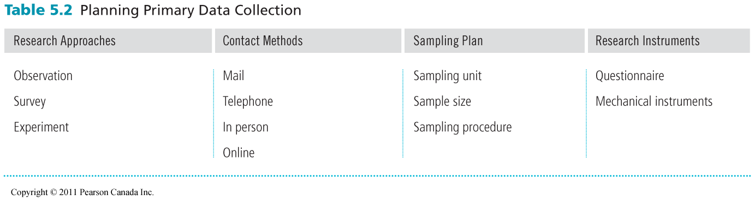
Primary Data
Primary research decisions:
主要研究决定：
研究方法
联系方式
抽样计划
研究仪器
Research approaches
Contact methods
Sampling plan
Research instruments

Slide 32
Primary Data
Research Approaches
Contact Methods
Sampling Plan
Research Instrument
使用人或机器进行观察研究
发现行为而不是动机
调查研究
对描述性信息有效
实验研究
调查因果关系
Observation research using people or machines
Discovers behavior but not motivations
Survey research
Effective for descriptive information
Experimental research
investigates cause and effect relationships

Slide 33
Primary Data
Research Approaches
Contact Methods
Sampling Plan
Research Instrument
主要联系方式包括：
邮件调查
电话调查
个人采访：
个人或焦点小组
在线研究
Key Contact Methods include:
Mail surveys
Telephone surveys
Personal interviewing:
Individual or focus group
Online research

Slide 34
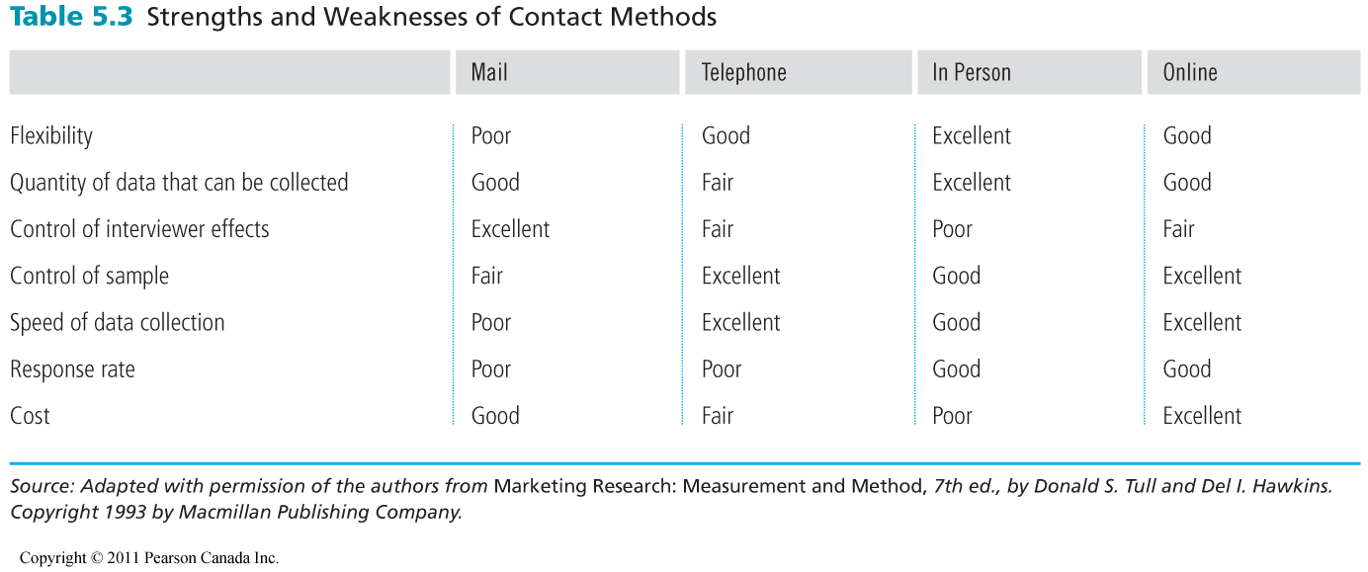

Slide 35
Primary Data
Research Approaches
Contact Methods
Sampling Plan
Research Instrument
样本：为营销研究选择的一部分人口，以代表整个人口
抽样计划决定：
采样单元
样本量
取样程序：
概率样本
非概率样本
Sample: a segment of population selected for marketing research to represent the population as a whole
Sampling Plan Decisions:
Sampling unit
Sample size
Sampling procedure:
Probability samples
Non-probability samples

Slide 36
Primary Data
Table 4.2 | Types of Samples
Probability Sample
Simple random sample | Every member of the population has a known and equal chance of selection.
Stratified random sample | The population is divided into mutually exclusive groups (such as age groups), and random samples are drawn from each group.
Cluster (area) sample | The population is divided into mutually exclusive groups (such as blocks), and the researcher draws a sample of the groups to interview.
Nonprobability Sample
Convenience sample | The researcher selects the easiest population members from which to obtain information.
Judgment sample | The researcher uses his or her judgment to select population members who are good prospects for accurate information.
Quota sample | The researcher finds and interviews a prescribed number of people in each of several categories.

Slide 37
Primary Data
Research Approaches
Contact Methods
Sampling Plan
Research Instrument
问卷调查
包括开放式和封闭式问题
措辞和问题顺序是关键
机械仪器
尼尔森人流量表
结帐扫描仪
眼睛相机
Questionnaires
Include open-ended and closed-ended questions
Phrasing and question order are key
Mechanical instruments
Nielsen’s people meters
Checkout scanners
Eye cameras

Slide 38
Step 3: Implementing the Research Plan
Data is collected by the company or an outside firm
The data is then processed and checked for accuracy and completeness and coded for analysis
Finally the data is analyzed by a variety of statistical methods
数据由公司或外部公司收集
然后对数据进行处理并检查其准确性和完整性，并进行编码以供分析
最后通过多种统计方法对数据进行分析

Slide 39
Step 4: Interpreting and Reporting the Findings
The research interprets the finding, draws conclusions and reports to management
Managers and researchers must work together to interpret results for useful decision making
研究解释调查结果，得出结论并向管理层报告
管理人员和研究人员必须共同努力解释结果以做出有用的决策

Slide 40

Tony’s Pizza

Slide 41
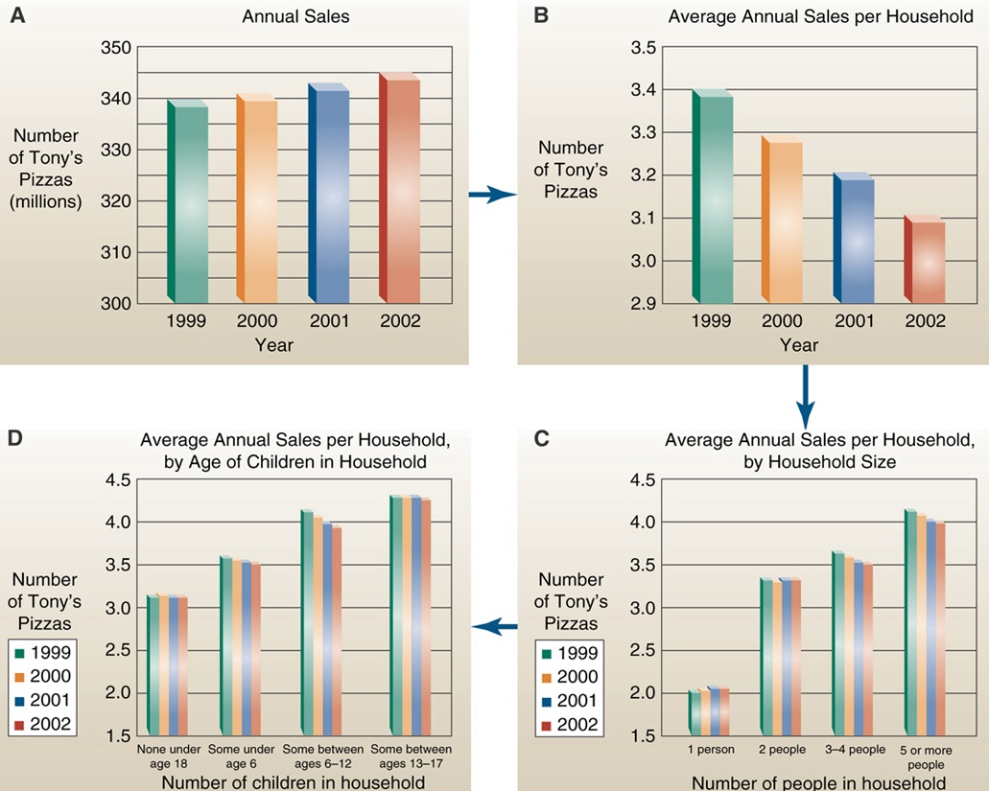

Slide 42
Marketing Info Systems Distributing and Using Marketing Information 分发和使用营销信息
Routine reporting makes information available in a timely manner.
User-friendly databases allow for special queries.
Intranets and extranets help distribute information to company employees and value-network members.
例行报告可以及时提供信息。
用户友好的数据库允许特殊查询。
内联网和外联网有助于将信息分发给公司员工和价值网络成员。

Slide 43
Video Discussion – Focus group
What are advantages and disadvantages of focus group interviewing?
Advantage:

Slide 44
Video Discussion – Focus group
Disadvantage:

Slide 45
Read chapter 5

